Slide 1
ISO 8583

Slide 2
What is ISO8583 ?
ISO 8583 is an international standard for financial transaction card originated interchange messaging.
It specifies a message format used by financial institutions, such as banks and payment processors, to exchange electronic transactions.
This standard defines the structure, content, and rules for messages exchanged between devices, such as point-of-sale (POS) terminals, automated teller machines (ATMs), and financial institutions' computer systems, during the authorization and processing of payment transactions.
ISO 8583 messages typically include information such as the type of transaction (e.g., sale, authorization, reversal), cardholder account details (e.g., card number, expiry date), transaction amount, terminal information, and authorization response codes.
The format of ISO 8583 messages is highly flexible and can be customized to accommodate various types of transactions and data elements.
This standard is crucial for ensuring interoperability and consistency in electronic payment systems, allowing different banks, payment networks, and financial institutions to communicate effectively and process transactions securely.
It helps facilitate the authorization, clearing, and settlement of payment transactions, contributing to the smooth operation of the global financial system.

Slide 3
Introduction of ISO8583 into Banking System
Overview of the history and development of ISO 8583:
ISO 8583 was first introduced by the International Organization for Standardization (ISO) in the 1980s.
It has undergone several revisions and updates to accommodate evolving technologies and industry requirements.
Milestones and key revisions:
Notable revisions include ISO 8583:1987, ISO 8583:1993, and ISO 8583:2003
Before ISO 8583, different banks and financial institutions used their own proprietary formats for processing electronic transactions. This lack of standardization made it difficult for systems from different vendors to communicate with each other. ISO 8583 provided a common language or format for these systems to exchange transaction data, ensuring interoperability and compatibility between different systems and networks.

Slide 4
Advantages of ISO8583
1.Interoperability:ISO 8583 provided a common language or format for these systems to exchange transaction data, ensuring interoperability and compatibility between different systems and networks.
2.Efficiency:With a common message format like ISO 8583, banks and payment systems can automate transaction processing, reduce manual intervention, and handle high transaction volumes more effectively.
3.Reliability:By defining specific fields and data elements within transaction messages, ISO 8583 reduces the risk of errors, misinterpretations, and data inconsistencies during transaction processing. This enhances the overall reliability and integrity of the banking and payment systems.
4.Security:ISO 8583 includes provisions for incorporating security features and protocols into electronic transaction messages. This helps protect sensitive information, such as cardholder data and transaction details, from unauthorized access, interception, and tampering. By adhering to ISO 8583 standards, banks and financial institutions can strengthen the security of their electronic payment systems and mitigate the risk of fraud and data breaches.
5.Globalization:ISO 8583 provides a universal framework for electronic transactions that can be used by banks, payment networks, merchants, and other financial institutions worldwide, regardless of geographical location or technological infrastructure.

Slide 5
ON-US Transaction: where the issuing bank and the acquiring bank are the same entity OFF-US Transaction: where the issuing bank and acquiring bank are different entities
Types of transactions
On-Us Transaction Flow:
1. Customer (Bank A): The customer initiates a withdrawal transaction at an ATM owned by Bank A.
2. Bank A: Bank A processes the withdrawal request internally since the transaction is within its own network (on-us).
3. Withdrawal Approved: Bank A approves the withdrawal request since it's within its own network, and the requested amount is within the customer's account balance.
4. Dispense $100: The ATM dispenses $100 cash to the customer.
5. Transaction Receipt: Bank A prints a transaction receipt for the customer, confirming the successful withdrawal.
Off-Us Transaction Flow:
1. Customer (Bank B): The customer initiates a withdrawal transaction at an ATM owned by Bank A (a different bank).
2. Bank A: Bank A forwards the withdrawal request to Bank B since it's an off-us transaction.
3. Bank B: Bank B receives the withdrawal request and processes it.
4. Authorization Response: Bank B sends an authorization response back to Bank A, approving or declining the withdrawal request.
5. Dispense $100: Bank A receives the authorization response and dispenses $100 cash to the customer if the request is approved.
6. Transaction Receipt: Bank A prints a transaction receipt for the customer, confirming the successful withdrawal.

Slide 6
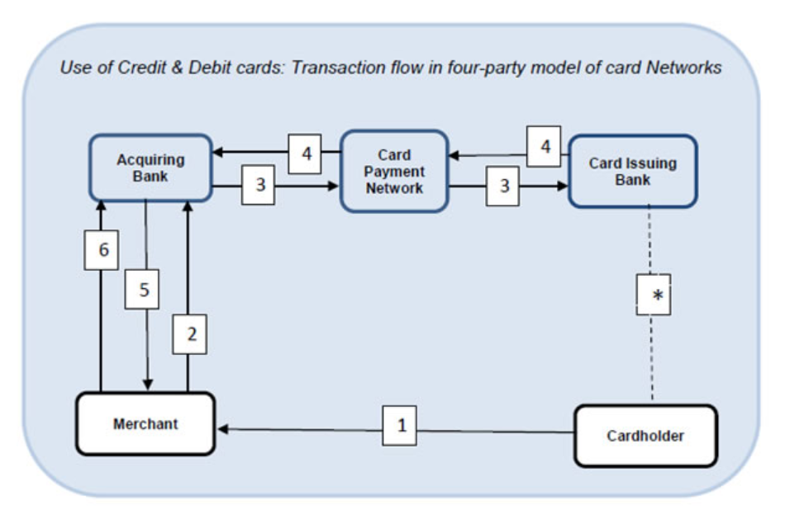
Workflow model of how transaction works
Field | Representation
1 | A consumer purchases some goods / services and uses a debit / credit card to pay the merchant.
2 | The merchant (terminal) sends the encrypted transaction data to the acquiring bank system / switch for authorization.
3 | The acquiring bank sends the transaction data to the consumer’s (card issuing) bank over the card payment network.
4 | The issuing bank authenticates the card / cardholder details; based on successful authentication and after checking availability of balance (for debit card) or credit limit (for credit card) authorizes the amount and issues an authorization code or declines the transaction.
5 | The acquiring bank notifies the merchant that the transaction either has been authorized or declined; the merchant then completes the transaction (if successful, then print receipt and hand over the goods, etc.)
6 | Subsequently, the merchant, through the acquiring bank, will claim the settlement for funds. The inter-bank settlement (between issuing bank and acquiring bank) will take place through the card network.
In case of debit card, the customer’s account is debited by the card issuing bank after authentication of the credentials and if balance is available; in the case of credit card, the bank will reduce the available credit limit in the customer’s card account and the same will be reflected in the credit card statement.

Slide 7
Parts of ISO8583 Message
1. Message Type Indicator (MTI):
The Message Type Indicator (MTI) is a four-digit numeric code that identifies the overall purpose and format of the message.
The MTI provides information such as the type of transaction (e.g., authorization request, financial request, reversal), message class (e.g., authorization, financial), and message function (e.g., request, response).
2. Bitmaps:
Bitmaps are used to indicate the presence or absence of data elements within the message.
Primary Bitmap: Represents the first 64 data elements.
Secondary Bitmap: Used when more than 64 data elements are present in the message.
Each bit in the bitmap corresponds to a specific data element, with a set bit indicating the presence of the corresponding data element.
3. Data Elements:
Data elements carry specific information related to the transaction, such as account numbers, transaction amounts, dates, and additional data.
Data elements are organized in a fixed format and identified by numeric identifiers ranging from 2 to 128.
Examples of common data elements include the Primary Account Number (PAN), Processing Code, Amount, and Terminal Identification.

Slide 8
- The Message Type Indicator (MTI) is a four-digit numeric code used in ISO 8583 messages to indicate the overall purpose and format of the message. - MTI serves as a vital identifier in ISO 8583 messages. It provides essential information about the transaction type and origin. - Understanding MTI is crucial for interpreting and processing electronic financial transactions accurately.
MTI
The structure of the MTI typically follows the format: ABCD
ABCD
Example :
Digit | Meaning
Message Class (A): | Indicates the general category or class of the message.
Message Function (B): | Specifies the specific function or purpose of the message within its class.
Message Origin (C): | Indicates the source or origin of the message.
Location of the message source (D): | Position four of the MTI defines the location of the message source within the payment chain.
0100 | Authorization Request | Request from a point-of-sale terminal for authorization for a cardholder purchase
0110 | Authorization Response | Request response to a point-of-sale terminal for authorization for a cardholder purchase

Slide 9
Bit Map
Bitmaps are fundamental components of ISO 8583 messages used to indicate the presence or absence of data elements within the message.
Primary Bitmap covers the first 64 data elements, while the Secondary Bitmap extends beyond.
Efficiently represents data element presence, optimizing message size and processing.
A Bitmap will be represented in hexadecimal value primary bitmap will be 16 digits and secondary bitmap will be additional 16 digits to find the field present in the particular ISO massage convert the hex values into binary values where 16 Hex digits will be converted to 64 Binary digits [64 fields].
The 1st digit of the converted binary value represents the 1st field. If the binary value is 0 it indicates the particular is empty if the value is 1 it indicates the field contains data.
Example:
The 3rd digit from the left (Converted to Binary) indicates the field 3 of the ISO Message, The value 1 implies the field 3 of the ISO message is present in the ISO Messge.
Bit Map | 3230058020C09200
Converted to Binary | 0011001000110000000001011000000000100000110000001001001000000000

Slide 10
Message or Data elements
Data elements are essential components of ISO 8583 messages, containing specific information about a transaction.
Data elements are organized in a fixed format and identified by numeric identifiers ranging from 2 to 128.
Data elements provide essential information for processing and authorizing transactions.
They enable interoperability between different systems and ensure accurate transaction processing.
Understanding data elements is crucial for accurate transaction processing and interoperability within the payment ecosystem.
Common data elements include PAN, Processing Code, Amount, Date and Time, TID, MID, and Authorization Code.
Examples:
Primary Account Number (PAN) : Unique identifier for the cardholder's account.
Processing Code : Indicates the type of transaction (e.g., sale, withdrawal, balance inquiry).
Amount : Transaction amount, typically in cents or smallest currency unit.
Date and Time : Timestamp indicating when the transaction occurred.
Terminal Identification (TID) : Identifier for the terminal initiating the transaction.

Slide 11
Field Identifiers (Type of data present in the field)
Abbreviation | Meaning
a | Alpha, including blanks.
n | Numeric values only.
x + n | Numeric (amount) values, where the first byte is either 'C' to indicate a positive or Credit value, or 'D' to indicate a negative or Debit value, followed by the numeric value (using n digits).
S | Special characters only.
an | Alphanumeric.
as | Alpha & special characters only.
ns | Numeric and special characters only.
ans | Alphabetic, numeric and special characters.
anp | Alphabetic, numeric and pad characters.
b | Binary data
p | Pad character, space
z | Tracks 2 and 3 code set as defined in ISO/IEC 7813 and ISO/IEC 4909 respectively
. or .. or ... | variable field length indicator, each . indicating a digit.
x or xx or xxx | fixed length of field, or maximum length in the case of variable length fields.

Slide 12
Field Identifiers (Length of data present in the field)
Note : LL and LLL are hex or ASCII
Example:
Type | Meaning
Fixed | no field length used
LLVAR or (..xx) | Where 0 < LL < 100, means two leading digits LL specify the field length of field VAR
LLLVAR or (...xxx) | Where 0 < LLL < 1000, means three leading digits LLL specify the field length of field VAR
Field Definition | Meaning
n 6 | Fixed length field of six digits
n.6 | LVAR numeric field of up to 6 digits in length
a..11 | LLVAR alpha field of up to 11 characters in length
b...999 | LLLVAR binary field of up to 999 bytes in length

Slide 13
Key Field in ISO8583
STAN and RRN play essential roles in transaction tracking, reconciliation, fraud prevention, customer service, and regulatory compliance within payment processing systems. They ensure the smooth and secure operation of electronic transactions while facilitating efficient communication and record-keeping among various stakeholders in the payment ecosystem.
Track 2 data is crucial for card-present transactions where the card is swiped through a magnetic stripe reader. This includes the card number (PAN), expiration date, service code, and discretionary data. It's essential for processing card-present transactions securely.
Field Number | Name | Meaning
11 | System Trace Audit Number (STAN): | STAN provides a unique identifier for each transaction initiated within the system.
37 | Retrieval Reference Number (RRN) | RRN uniquely identifies each transaction and facilitates the retrieval of transaction details from the issuer's system.
Field Number | Name | Meaning
35 | Track 2 Data | It carries data from the magnetic stripe of a payment card, specifically the information contained in Track 2
52 | PIN Data | PIN Data is encrypted information related to the PIN entered by the cardholder during a transaction.
55 | EMV Data | It carries data related to EMV (Europay, Mastercard, and Visa) chip transactions.

Slide 14
Field 55
It carries supplementary transaction information beyond core elements.
Contents include EMV tags, application, terminal, card, issuer data, cryptographic values, and transaction specifics.
Variable content based on transaction type, EMV standards, network requirements, and system needs.
Proper handling essential for transaction security, authorization, and processing.
Tag 9F26: ARQC (Application Request Cryptogram):
What it is: ARQC is a cryptographic code generated by the chip in a payment card during a transaction.
Purpose: It serves as proof that the card is genuine and that the transaction data hasn't been tampered with.
Generation: The chip calculates the ARQC based on transaction data, a unique secret key, and other parameters.
Verification: The ARQC is sent to the card issuer during transaction authorization. The issuer verifies its authenticity to approve the transaction.
Tag 9F36: ATC (Application Transaction Counter):
What it is: ATC is a counter maintained by the chip in the payment card to track transaction activity.
Purpose: It helps prevent replay attacks, where a captured transaction is fraudulently reused.
Incrementation: The chip increments the ATC with each transaction it processes.
Verification: The ATC value is part of the data used to generate the ARQC. It ensures that each transaction has a unique identifier.
Resetting: The ATC may reset periodically or when certain conditions are met, such as reaching its maximum value.
Security: ATC adds an additional layer of security by ensuring that each transaction is uniquely identified, thus mitigating the risk of replay attacks.

Slide 15
Additional Contents of ISO8583 messages
Header:
- The Header contains additional information about the message, such as network identifiers, source and destination information, and routing details.
- The Header may vary depending on the specific implementation and requirements of the ISO 8583 messaging system.
Trailer:
- The Trailer marks the end of the message and may contain additional control information or checksums for message integrity verification.
- The Trailer ensures that the message is complete and has not been altered during transmission.

Slide 16
Switch
"switch" typically refers to a computer system or software application that acts as an intermediary or central hub for routing and processing electronic transactions between various entities within the banking ecosystem. Switches play a crucial role in facilitating communication and interoperability between different banks, payment networks, merchants, and other financial institutions.
Here are some key functions and roles of a switch in banking:
1. Transaction Routing: A switch routes transaction data between different entities involved in a transaction, such as the customer's bank (issuer), the merchant's bank (acquirer), payment networks (e.g., Visa, Mastercard), and other intermediaries.
2. Authorization and Authentication: The switch facilitates the authorization and authentication of transactions by coordinating communication between the customer's bank and the merchant's bank. It sends authorization requests to the issuer bank and receives authorization responses, indicating whether a transaction should be approved or declined based on factors such as available funds, transaction limits, and fraud detection rules.
3. Network Interoperability: Switches ensure interoperability between different payment networks and systems, allowing transactions to be processed seamlessly across various platforms and channels. They support different types of payment methods, including debit cards, credit cards, mobile payments, and online transactions.

Slide 17
4. Transaction Processing: Switches manage the processing of transactions in real-time, including transaction validation, settlement, and reconciliation. They ensure that transactions are processed accurately and efficiently, adhering to regulatory requirements and industry standards.
5. Security and Fraud Prevention: Switches incorporate security measures and fraud prevention mechanisms to safeguard electronic transactions against unauthorized access, data breaches, and fraudulent activities. They employ encryption, tokenization, and authentication techniques to protect sensitive information and mitigate risks.
6. Monitoring and Reporting: Switches provide monitoring and reporting capabilities to track transaction volumes, performance metrics, and compliance with regulatory guidelines. They generate transaction logs, audit trails, and reports for analysis, reconciliation, and regulatory reporting purposes.

Slide 18
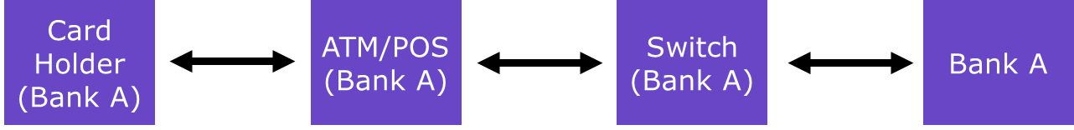
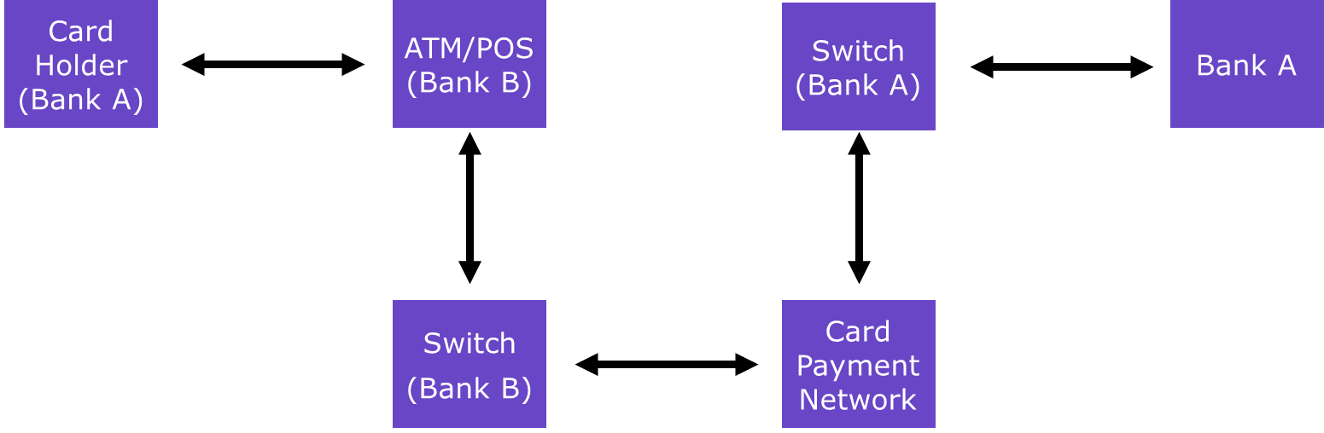
Roll of Switch in Card Transactions
ON_US Transaction
OFF_US Transaction

Slide 19
JMeters involvement
Switch Testing :
JMeter will mimic card payment network (VISA/MASTER) in OFF-US transaction and JMeter will mimic ATM/POS in ON-US transaction.
Core Banking Testing :
JMeter will mimic Switch of the Bank.
Reference sites :
Bit Map Calculator : ISO8583 Bitmap Calculator Online. ISO8583 Fields Decoder and builder (neapay.com)
List of EMV Tags : EMV tags list reference - All EMV tags (neapay.com)
List of Available channels : https://jpos.org/doc/javadoc/org/jpos/iso/channel/package-summary.html
List of available class for package configuration : https://admhelp.microfocus.com/sv/en/2023-2023-r1/Help/Content/UG/c_ISO8583_jPOS.htm

Slide 20
JMeter components involved in ISO 8583 message scripting
ISO 8583 Connection Configuration
ISO 8583 Connection Configuration element facilitates configuring connections for sending ISO 8583 messages to a server.
Key Parameters:
Server Name/IP: Target server's address.
Port Number: Server's listening port.
Channel Header : Value to be added in front of all the ISO Message which uses the specific channel.
Channel Class : Specifies the Header in front of the iso message.
Field Packager Class: ISO 8583 message parsing/formatting.
Request Listener : Used for sending automatic replies to the message from the receiver.
2.ISO8583 Crypto Pre-Processor
Module that handles cryptographic operations on ISO 8583 messages before they are transmitted over a network. This component is responsible for generating PIN Block (Field 52) and EMV Tag 9F26 (ARQC).

Slide 21
3.ISO 8583 sampler
ISO 8583 Sampler enables sending ISO 8583 messages to simulate transactions.
Key Parameters:
Message Header: Initial metadata containing message type, version, and length.
Message Trailer: Marks end of message, often includes integrity check data.
Timeout: Maximum duration for transaction processing.
Response Code Field: Outcome indicator for transaction success or failure.
Success Response Code: Code denoting successful transaction completion.
Message Construction:
Field : Field Number
Content : Values that need to be send in the field
Tag : included only if there are sub fields inside a field.

Slide 22
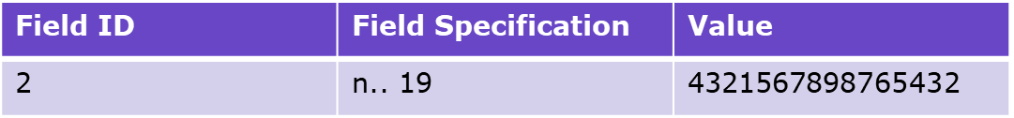
XML Packager (Field Specification packager)
XML Packager is responsible for translating ISO 8583 message fields into XML format or vice versa. This component is crucial for converting ISO 8583 messages, which are typically represented in binary or ASCII format, into XML format for easier processing, manipulation, and integration with XML-based systems.
Example :
<isofield id="2" length="19" name="PAN - PRIMARY ACCOUNT NUMBER" class="org.jpos.iso.IFA_LLNUM"/>
<isofield id="3" length="6" name="PROCESSING CODE" class="org.jpos.iso.IFA_NUMERIC"/>
Field ID | Field Specification | Value
3 | N 6 | 0120000

Slide 23
Types Of Establishing Connection Between JMeter and Switch
Client Mode
The connection will be established starting from JMeter to Switch.
Server Mode
The connection will be established starting from Switch to JMeter.
Sign On Message:
Identity Verification: Authenticate terminals, devices, or users before accessing transaction systems.
Access Control: Determine the level of access granted to authenticated entities based on permissions and roles.
Secure Communication: Establish a secure channel for transmitting transaction data between terminals/devices and host systems.
Data Protection: Implement security measures such as encryption and digital signatures to safeguard transaction information.
Auditing: Maintain a log of user activity to track access and actions for compliance and security purposes.

Slide 24
Flow of completing Sign On between JMeter and Switch
1
JMeter
Switch
1-JMeter establishes connection with Switch
2-Switch sends a Sign On (0800) to JMeter
3-Jmeter sends a 0810 to Switch
2
3
Switch
1
JMeter
2
1-Switch establishes connection with JMeter
2-Switch sends a Sign On (0800) to JMeter
3-Jmeter sends a 0810 to Switch
3
JMeter
1
Switch
2
1-JMeter establishes connection with Switch
2-JMeter sends a Sign On (0800) to Switch
3-Switch sends a 0810 to JMeter
3
1
Switch
JMeter
2
1-Switch establishes connection with JMeter
2-JMeter sends a Sign On (0800) to Switch
3-Switch sends a 0810 to JMeter
3

Slide 25
Types of transaction based on Response from Switch
Successful Transaction.
When a response is received from Switch to JMeter for the transaction (irrespective of valid or invalid transaction).
Unsuccessful Transaction.
When there is no response from Switch to JMeter for the transaction.
Pass Transaction.
When a response is received from Switch to JMeter for the transaction and the it is a valid transaction (field 39 will be marked as 00).
Failed Transaction.
When a response is received from Switch to JMeter for the transaction and the it is a Invalid transaction (field 39 will be marked other than 00).

Slide 26
Thank you for your attention
Prince Infocity II, 6A, 6th Floor
No. 283/3 & 283/4 | Rajiv Gandhi Salai (OMR)
Kandanchavadi | Chennai – 600096 | India

